Slide 1
Intro to FTC Setup and Code
Don’t panic!
https://github.com/JimWright4089/FIRSTWorkshops

Slide 2
Intro
Things covered in this class:
Setting up the Hardware
Block Programming
OnBot Java

Slide 3
Setting up the Hardware
Good news! Things are back in stock.
If your team can afford it, buy a Control Hub and Drivers Hub
REV Robotics has a tool.
https://github.com/JimWright4089/FIRSTWorkshops

Slide 4
Best setup
One Control Hub
One Expansion Hubs
One Drivers Hub (still in stock)
https://github.com/JimWright4089/FIRSTWorkshops

Slide 5
REV Robotics Tool
REV has an amazing tool to update firmware.
https://github.com/REVrobotics/REV-Software-Binaries.
REV-Hardware-Client-Setup-1.4.3.exe
We require the default password to be changed. If you do, you can find what it’s set to through this tool!
https://github.com/JimWright4089/FIRSTWorkshops

Slide 6
Setting up the phones
The software is no longer on Google Play.
REV Hardware Client to the rescue
You can download either the Robot Controller or the Drivers Station
https://github.com/JimWright4089/FIRSTWorkshops

Slide 7
Setting up the phones/ or other junk
Under the settings you will find tools to set the names of the phones or other junk.
<team number>-DS for Driver station
<team number>-RC for Robot Controller
Spare thingys use letters between the team number and the –XX. Like 4444-B-RC

Slide 8
Setting up the phones
Connect the Driver station to a joystick, or hub with two joysticks connected to it, through a OTG cable.
Connect the Robot Controller to the Robot through a Mini B to Micro B cable.

Slide 9
Configuring the robot.
You need to configure the robot’s hardware.
Go into the driver’s station settings panel and choose Configure Robot.
If there are configuration on this page and you did not put them there, delete them, because they are for older robots.
Create a new configuration.

Slide 10
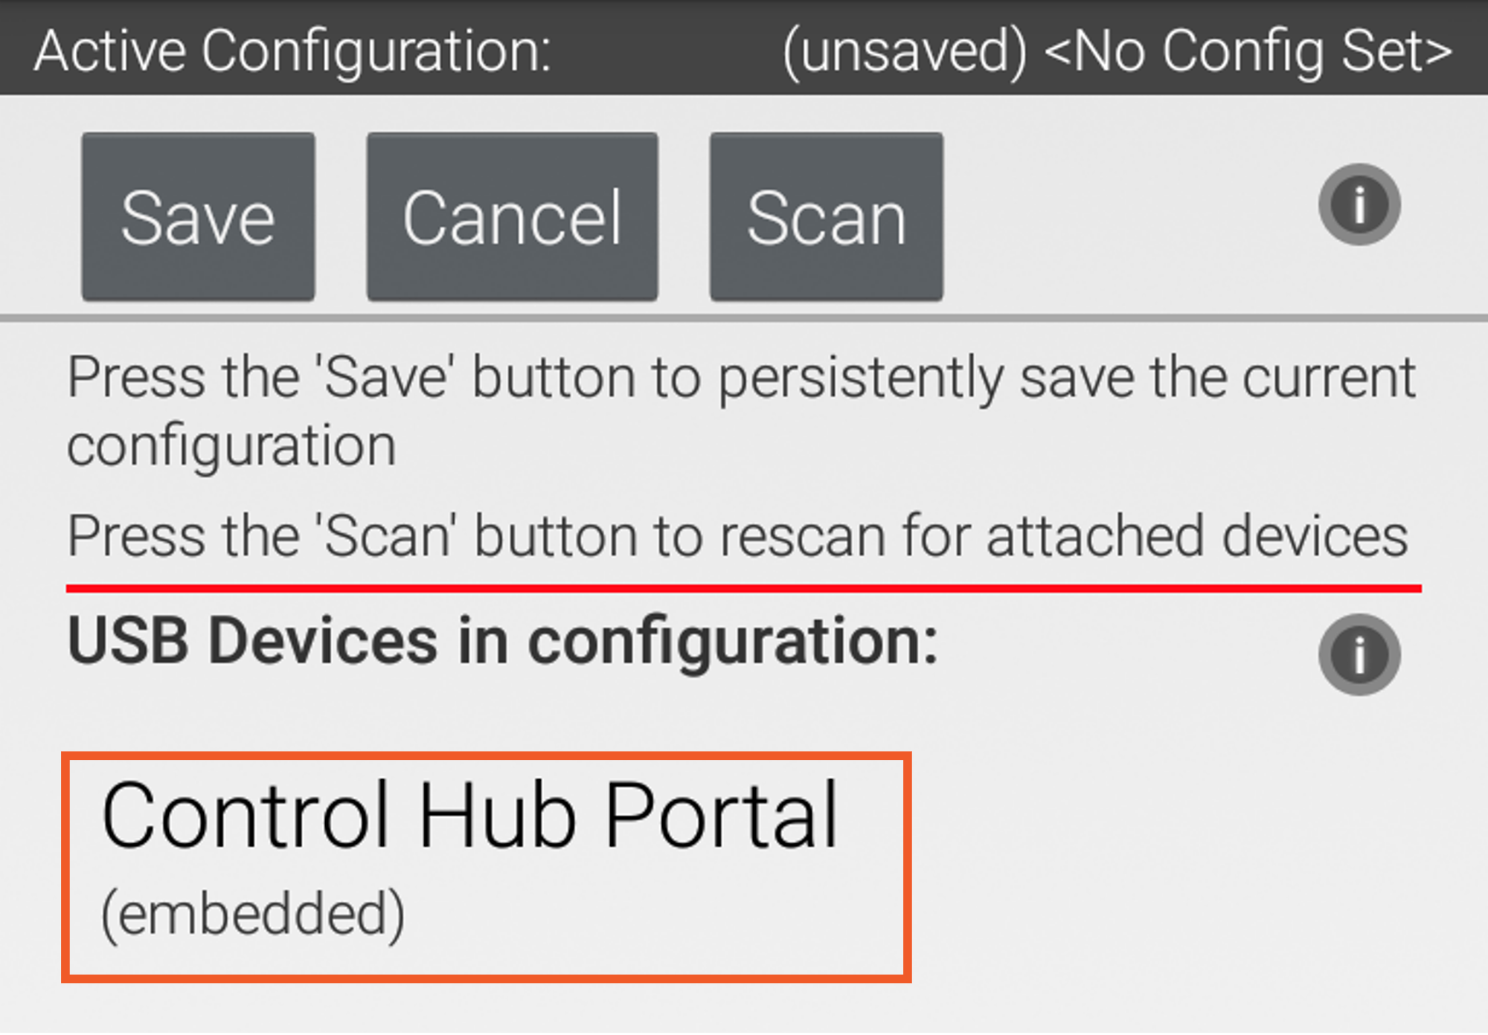
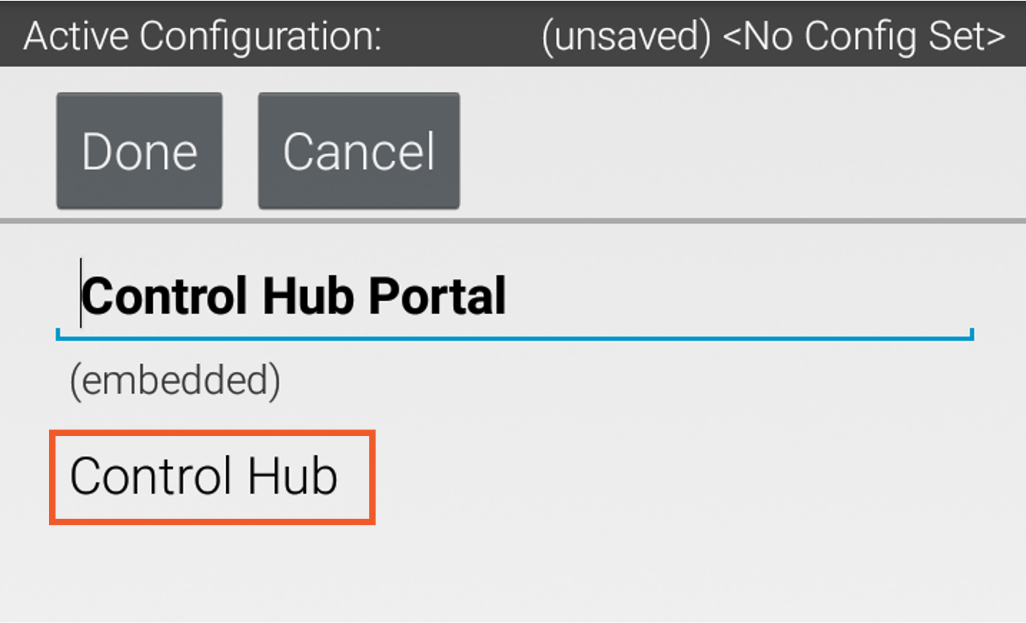
Configuring the robot.

Slide 11
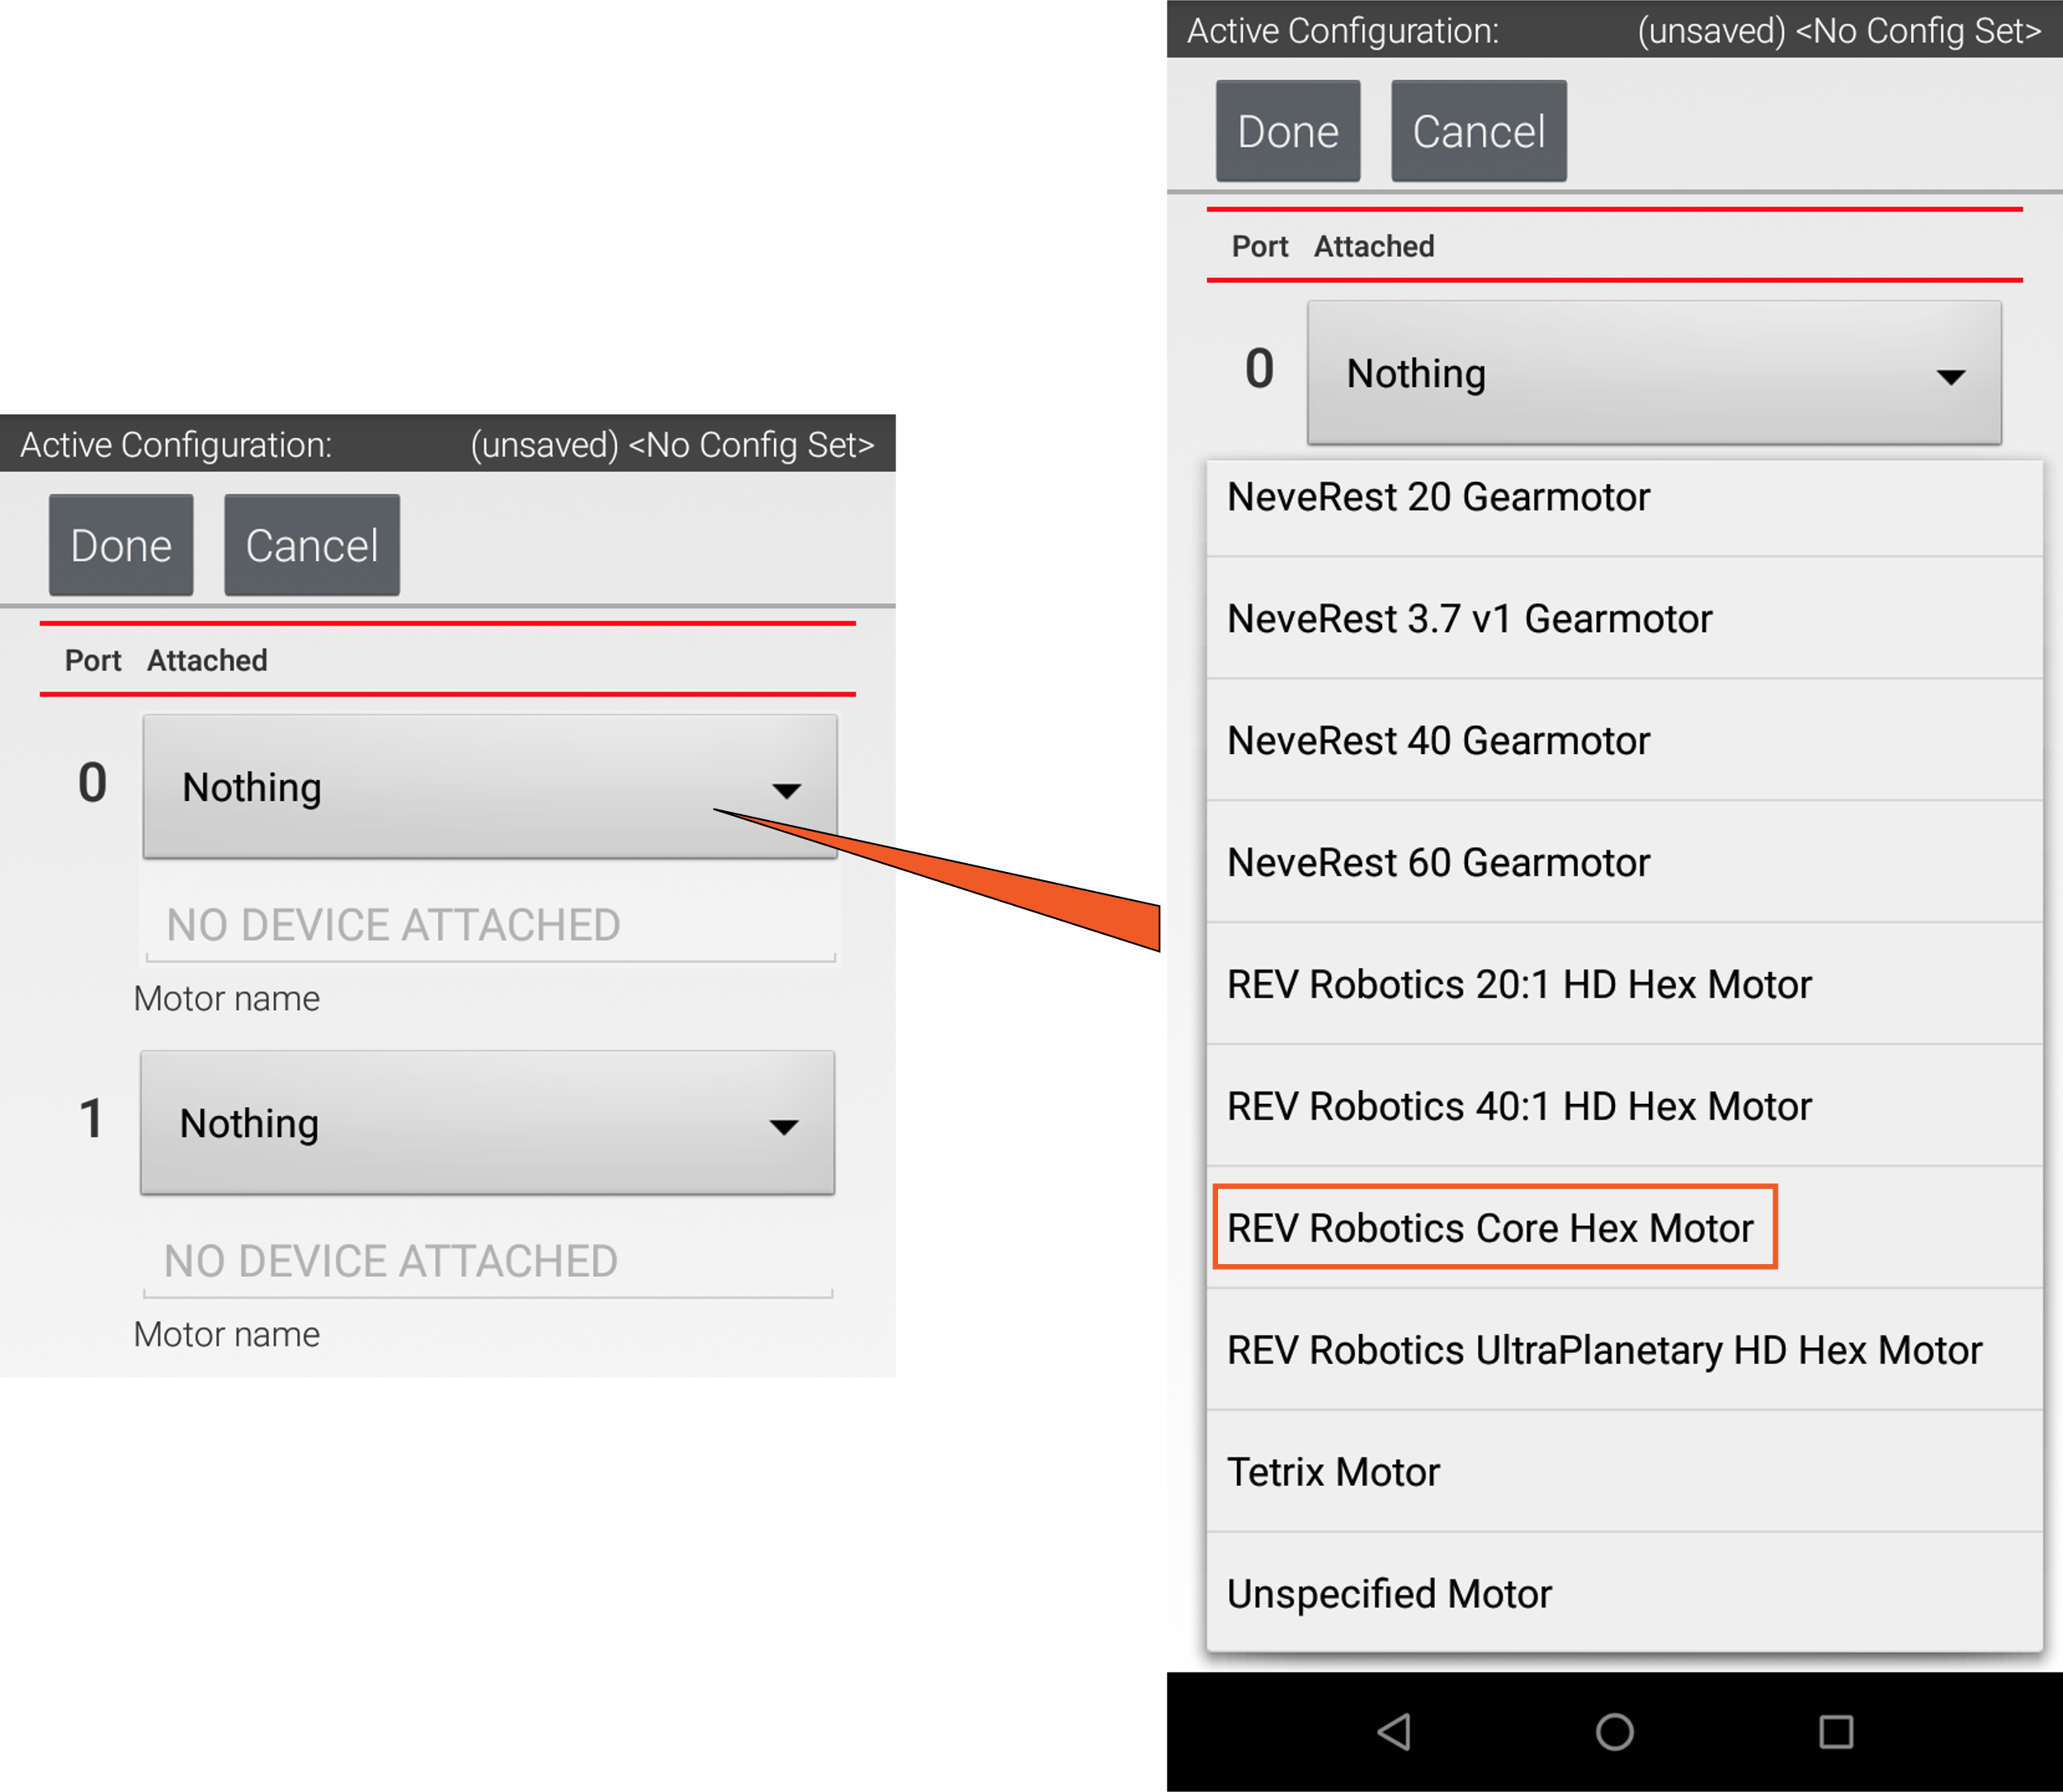
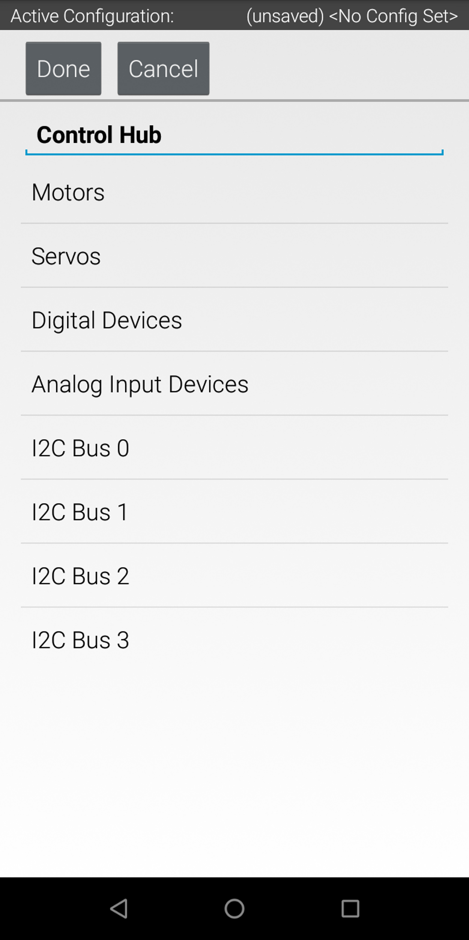
Configuring the robot.

Slide 12
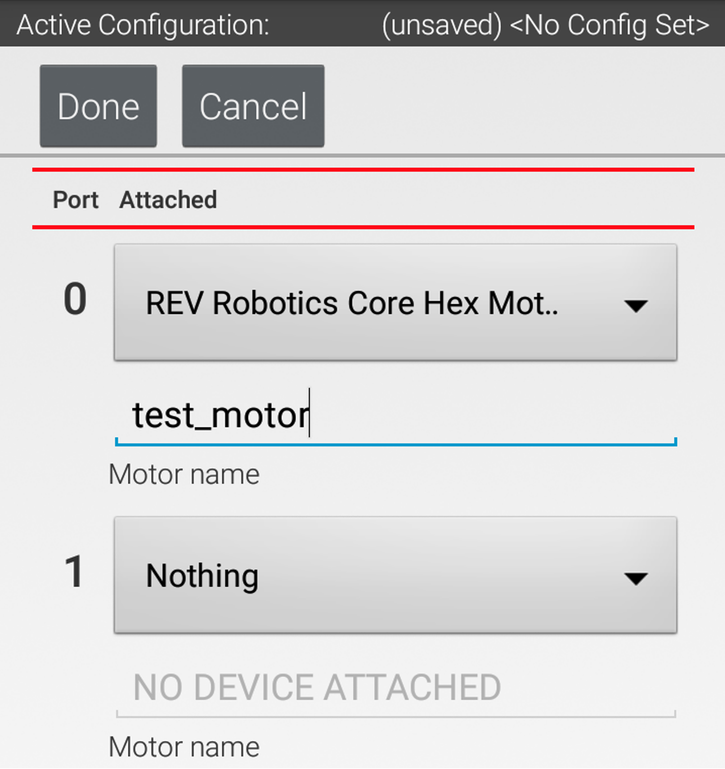
Configuring the robot.
In naming things make sure your write the exact name on a sheet of paper. You will need the EXACT name (caps and underscores count) for the program.

Slide 13
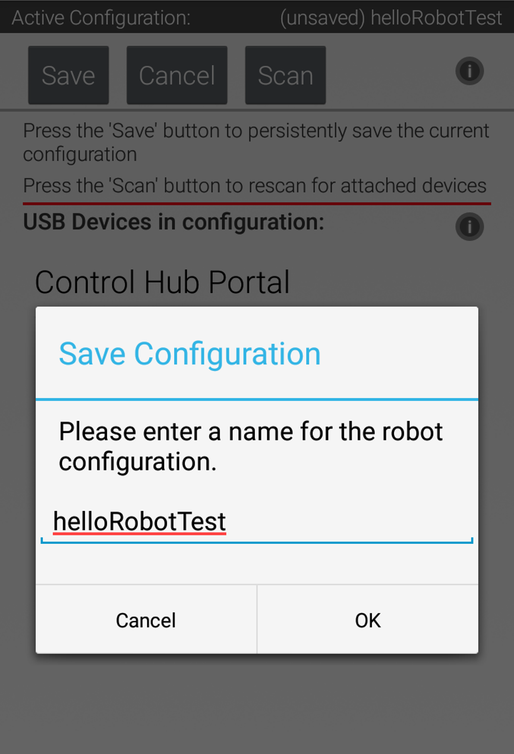
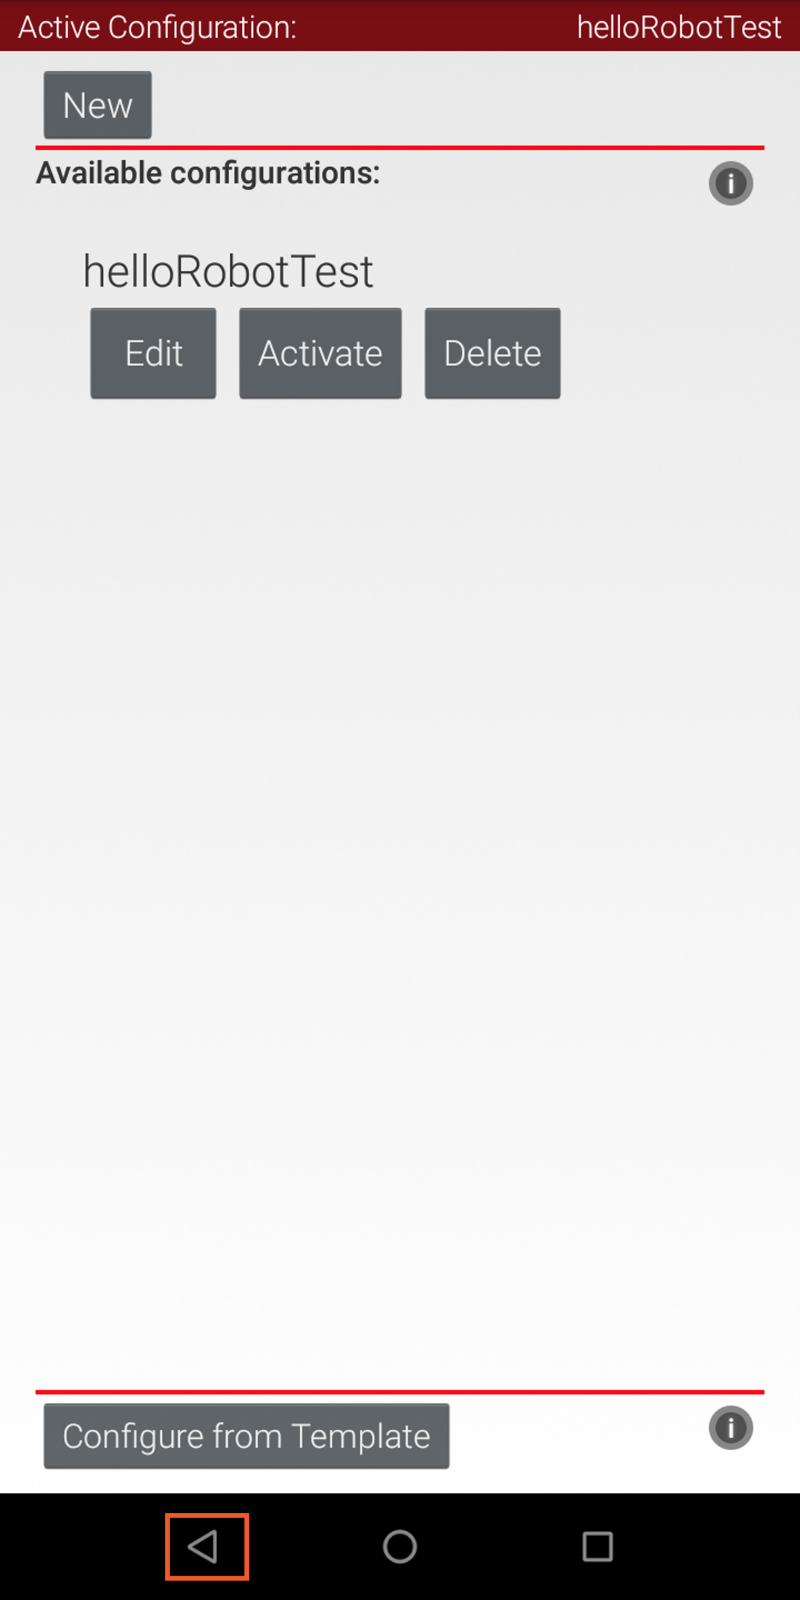
Configuring the robot.
Click on back until you can a ‘save’ option. Save the config as a name, and then Activate it.
The current config is in the upper right corner.

Slide 14
Programming
You have a bunch of ways to program your robot.
Block
OnBot Java
Andriod Studio

Slide 15
Kevin Ross is really smart.
I like using OnBot Java for my personal robots.
It’s quick and easy. I’ve been doing this since 2016.
However, it requires you to connect your WiFi to the robot. So to look stuff up on the internet you need to disconnect from the robot and connect back to the Internet.
Kevin pointed out we can get a Wifi/USB dongle and connect that to the internet.

Slide 16
Block and OnBot connection.
You will enable another WIFI connection to the Robot Controller
Use the Program and Manage menu item.
From this panel you will see the WIFI name and WIFI key for the robot controller

Slide 17
Block and OnBot connection.
You will enable another WIFI connection to the Robot Controller
Use the Program and Manage menu item.
From this panel you will see the WIFI name and WIFI key for the robot controller.
Point your browser to the IP address on the RC. Something like:
http://192.168.49.1:8080

Slide 18
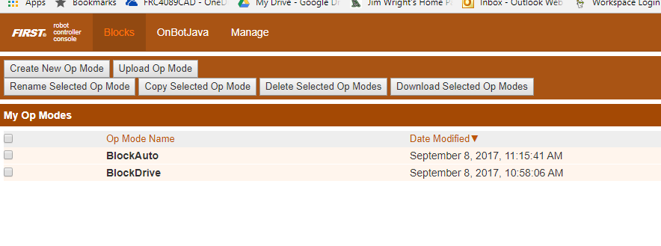
Block
Screen:

Slide 19
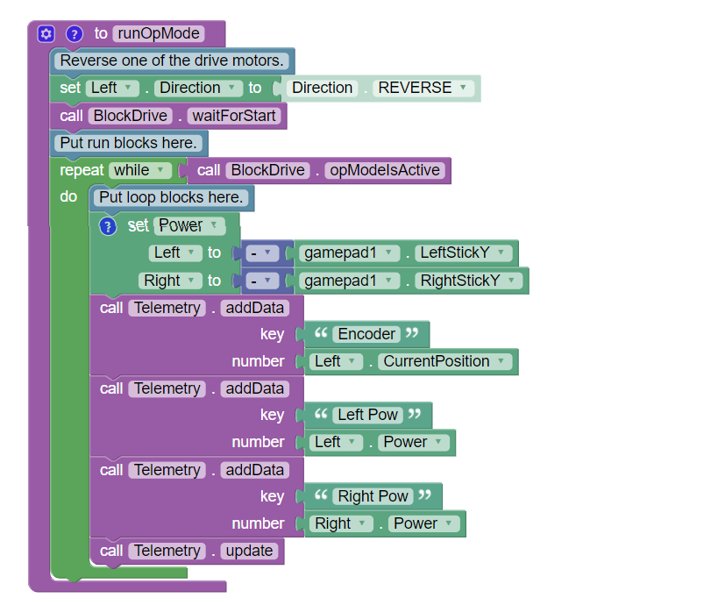
Block

Slide 20
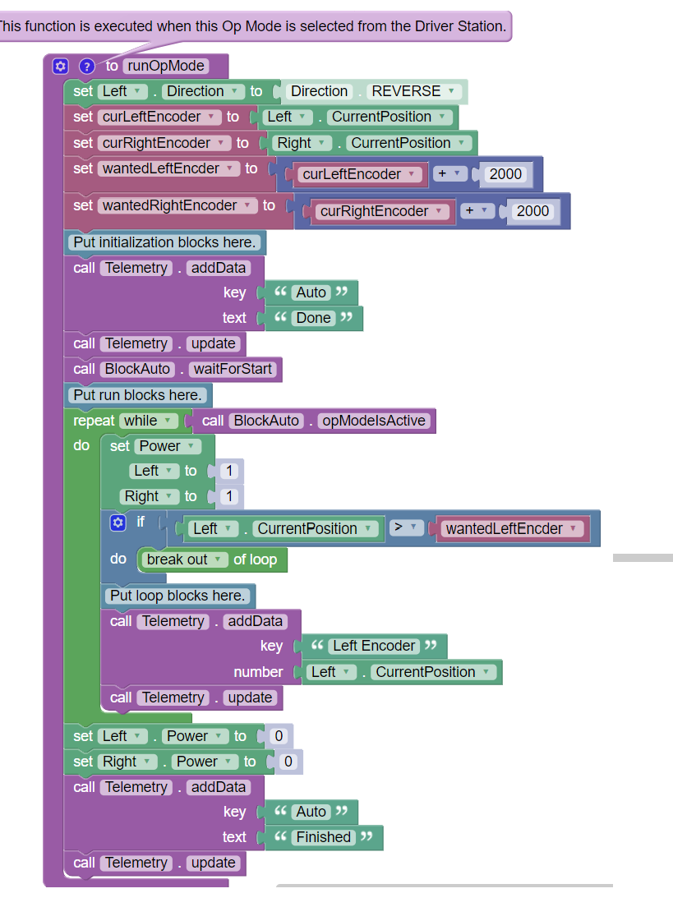
Block

Slide 21
OnBot
Standard Java, just on the robot!

Slide 22
OnBot
rightMotor = hardwareMap.dcMotor.get("Right");
rightMotor.setDirection(DcMotor.Direction.REVERSE);// Set to FORWARD if using AndyMark motors
rightMotor.setMode(DcMotor.RunMode.STOP_AND_RESET_ENCODER);
rightMotor.setMode(DcMotor.RunMode.RUN_WITHOUT_ENCODER);
waitForStart();
runtime.reset();

Slide 23
OnBot
while (opModeIsActive()) {
Integer rightEnc = rightMotor.getCurrentPosition();
telemetry.addData("Status", "Run Time: " + runtime.toString());
telemetry.addData("R Enocder", rightEnc.toString());
telemetry.update();
leftMotor.setPower(-gamepad1.left_stick_y);
rightMotor.setPower(-gamepad1.right_stick_y);

Slide 24
Andriod Studio
A lot more complicated than OnBoard Java
A lot more flexible as well.
A good tool to know
https://www.firstinspires.org/sites/default/files/uploads/resource_library/ftc/android-studio-guide.pdf
Git Hub keeps track of code.

Slide 25
Android Studio Setup
Download/Install JDK
https://www.oracle.com/java/technologies/downloads/
Download/Install Android Studio
https://developer.android.com/

Slide 26
FTC Project
Github has it.
https://github.com/FIRST-Tech-Challenge/FtcRobotController
You can download and use it from Github.
Better to fork the code into your Github project. This lets your team check in code.
Clone this project onto your hard drive.

Slide 27
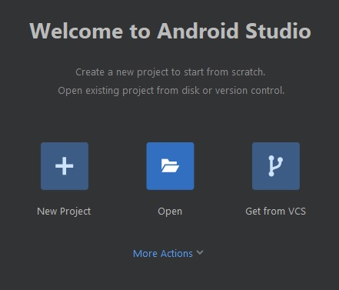
FTC Project
In Android Studio choose open.
Find the cloned project, it will have a little Andriod symbol on it.
It will take a while, to get the code and all of the libraries loaded the first time.

Slide 28
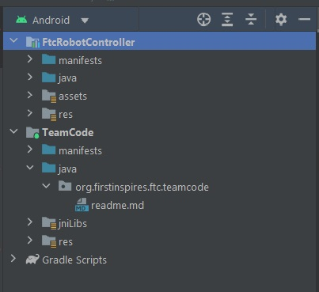
Your Code here!
Once everything is loaded, the explorer will be on the left.
Open up the Team Code directory.

